Slide 1
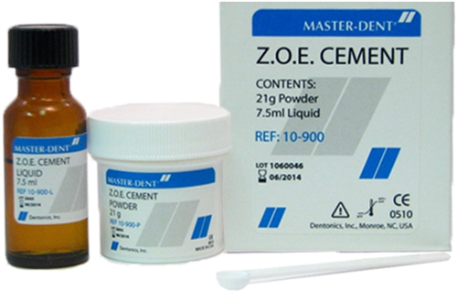
ZINC OXIDE EUGENOL CEMENT
Dr Divya Shetty

Slide 2
General Objective: At the end of the class the students should be able to understand properties, setting reaction, manipulation , uses & modifications of zinc oxide eugenol.

Slide 3
Specific Objectives:
At the end of the class, the students should be able to know:
✓ Introduction of zinc oxide eugenol
✓ Classification of zinc oxide eugenol
✓ Composition
✓ Setting reaction
✓ Manipulation
✓ General properties
✓ Application
✓ Factors affecting setting time
✓ Modification of ZOE cement
✓ Conclusion

Slide 4
CONTENTS:
INTRODUCTION
CLASSIFICATION
COMPOSITION
SETTING REACTION
INDICATION
PROPERTIES
MANUPILATION

Slide 5
MODIFICATIONS
CONTRAINDICATED
ADVANTAGES
DISADVANTAGES

Slide 6
INTRODUCTION
Zinc Oxide Eugenol have been used extensively in dentistry since the 1890’s.
Though other cements are also used for temporization, but zinc oxide eugenol cement is used most commonly because :
These cements are much less irritant to the pulp
These cements produce better marginal seal

Slide 7
CLASSIFICATION
According to ADA specification No 30, they are classified into 4 types according to their uses.
Type I : Temporary cementation
Type II : Permanent cementation
Type III : Temporary restoration
Type IV : Cavity lining

Slide 8

COMPOSITION
Composition of unmodified ZnOE cement
Ingredients | Weight % | Functions
Powder:-
Zinc oxide | 69% | Reactive ingredients
White rosin | 29.3% | Reduces the brittleness
Zn Stearate | 1% | Plasticizer
Zn Acetate | 0.7% | Accelerator
Liquid:-
Eugenol | 85% | Reactor
Olive oil | 15% | Plasticizer

Slide 9
SETTING REACTION
When the powder is mixed with the eugenol liquid following chemical reactions takes place, in presence of moisture.
ZnO + H2O Zn(OH)2
Zn(OH)2 + 2HE ZnE2 + 2H2O
Base Acid Salt
In the first step, hydrolysis of ZnO takes place. ZnO combines with H2O to form Zn(OH)2.
In the second step Zn(OH)2 combines with eugenol to form zinc oxide eugenolate and releases H2O.
AUTOCATALYTIC
REACTION

Slide 10
It is an autocatalytic acid- base reaction in which H2O is a by product. Without H2O the reaction will not proceed or does not exist.
The chelate forms an amorphous gel that tends to crystallize binding unreacted particles imparting strength to the set mass.

Slide 11
STRUCTURE OF SET CEMENT
The set cement consists of particles of ZnO embedded in the matrix of zinc eugenolate
Unreacted zinc oxide particles
Matrix of Zinc Eugenolate

Slide 12
INDICATIONS
Temporary cementation
Permanent cementation
Temporary filling
Lining
Base
Intermediate restoration
Root Canal Sealers
Pulp Capping

Slide 13
Applications
TEMPORARY CEMENTATION
Unmodified ZOE cements are also used as luting materials for provisional crowns and temporary cementation of metal restorations in crown and bridge prosthesis.

Slide 14
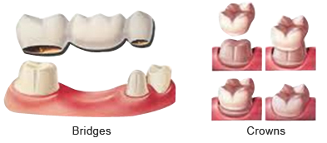
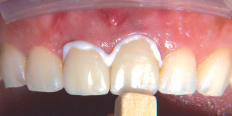

Slide 15
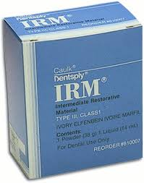
PROVISIONAL RESTORATIONS
Modified Zinc oxide eugenol have been tried as provisional restorations based on their physical properties. These cements were handled easily and had improved carvability which prevented chipping during trimming, and that symptomatic teeth without pulp exposure showed no symptoms.

Slide 16
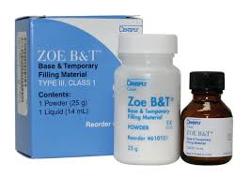
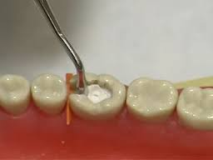
BASES
Materials having a compressive strength of 55MPa and the strength reaches a maximum in about 12 to 15 min.
The ZOE cements have the advantage that the thermal insulating properties of the cements are excellent and are approximately the same as those for human dentin.

Slide 17
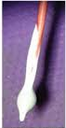
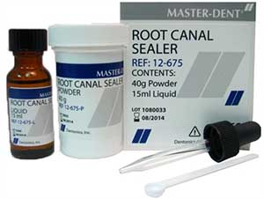
ENDODONTIC SEALERS
Endodontic ZOE preparations have been used as a root canal sealer with Gutta Percha. There are two major groups of products based on ZOE cements – conventional and therapeutic sealers.

Slide 18
PROPERTIES
BIOLOGICAL PROPERTIES
Zinc oxide eugenol has a PH of 7.
This makes it the least irritating cement.
It has a soothing effect on the pulp.
The release of eugenol by hydrolysis of zinc eugenolate matrix relieves pain in the pulp in deep cavities. Hence, these materials can be used as indirect pulp capping materials and to, reduce postoperative sensitivity.

Slide 19
There are however disadvantages of eugenol.
Eugenol is cytotoxic. Thus direct contact of eugenol with soft tissues should be avoided.

Slide 20
COMPRESSIVE STRENGTH
They are relatively weak cements.
The compressive strength ranges from low of 3-4 Mpa upto 50-55 Mpa.
THERMAL PROPERTIES
These materials have very low thermal conductivity.
They can act as thermal or chemical insulating material.

Slide 21
SOLUBILITY AND DISINTEGRATION
The solubility of the set cement is highest.
They disintegrate in oral fluid. Solubility is reduced by inreasing the P/L ratio.
FILM THICKNESS
It is an important factor for those cements used for luting of restorations.
The film thickness should be not more than 25um for cements used for permanent cementation and not more than 4o um for cements used for temporary cementation.

Slide 22
ADHESION
They do not adhere well to enamel or dentine. This is one reason why they are not used for final cementation of crown and bridges. The other reason are low strength and high solubility.
MIXING AND SETTING TIMES
Mixing time is about 1- 1.5 minutes.
Setting times :
Conventional ZnO eugenol cement: 4-10 minutes

Slide 23
Setting time is decreased by:
Smaller particle size
Accelerators like calcium chloride,
Moisture
High powder liquid ratio
Higher temperature, i.e warm glass slab and spatula

Slide 24
Setting time is increased by:
Larger particle size
Retarders like glycol or glycerine
Lower powder liquid ratio
Lower temperature without moisture contact i.e by cooling the glass slab and spatula, but not below the dew point.

Slide 25
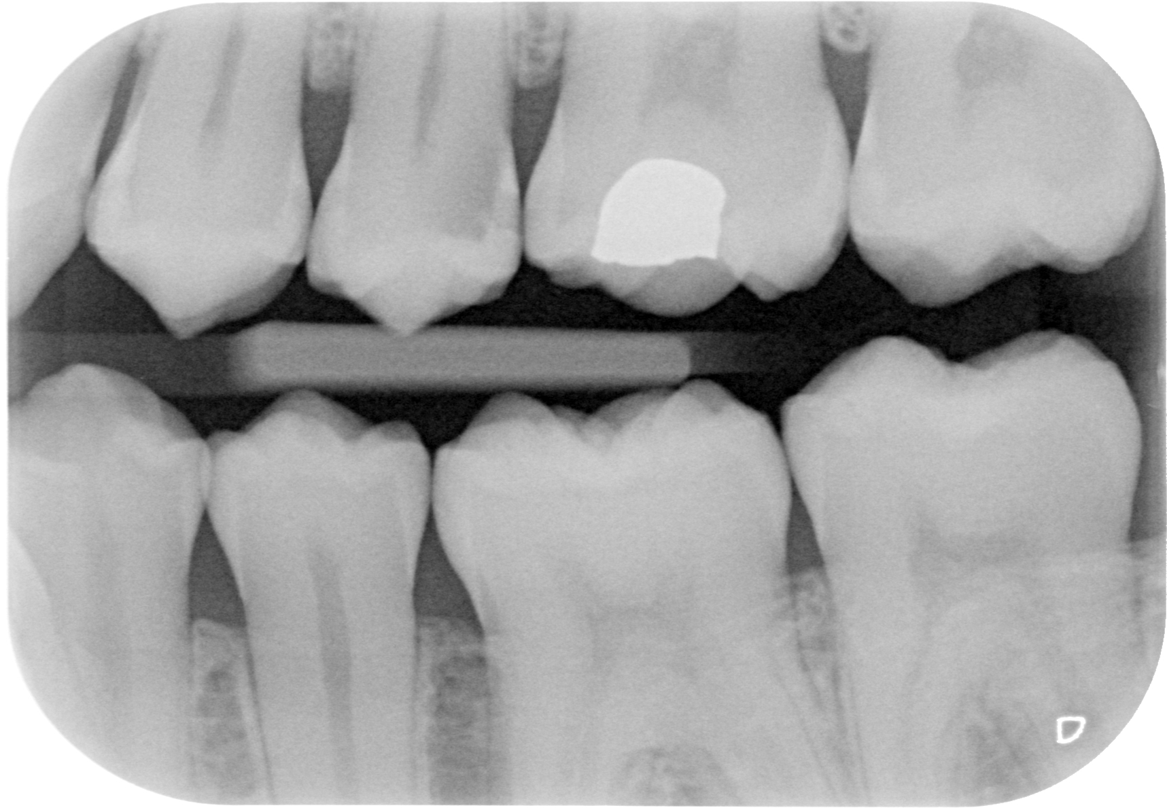
RETENTION
Zinc oxide eugenol cements do not adhere to the tooth structure chemically and retention is by physical means.
.9. RADIOPACITY

Slide 26
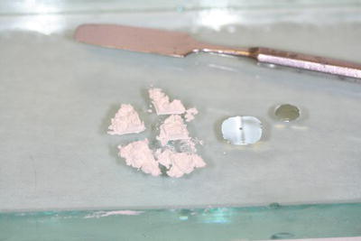
MANIPULATION:

Slide 27
INSTRUMENTS REQUIRED
Paper mixing pad with disposable sheets
Glass slab
Stiff bladed Stainless steel Spatula

Slide 28
Powder liquid ratio is approximately 3:1 or 4:1
Powder is measured and dispensed with a scoop where as liquid is dispensed as drops on glass slab.
Powder is divided in main bulk increment followed by smaller increments.
liquid
Small increments
Bulk increment

Slide 29
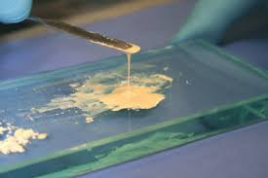
Mixing is started by adding one bulk increments then the small increments into the liquid and the mix is thoroughly spatulated with a heavy folding motion and pressure.
EXOTHERMIC REACTION: Larger surface is used to mix- to dissipiate the heat
For restorative consistency the mix should be thicker, non sticky and should be able to roll it on the glass slab.
For luting consistency, the mix should be thinner and have a creamy appearance.

Slide 30
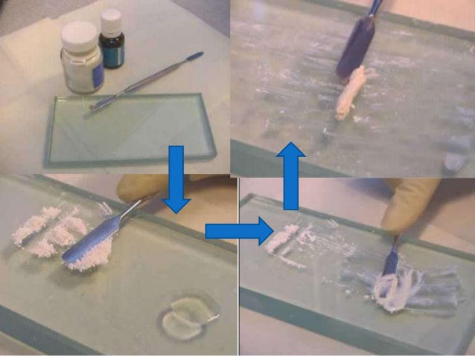

Slide 31
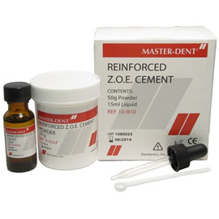
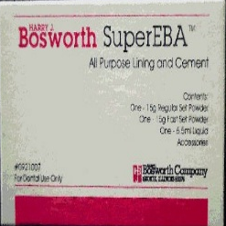
MODIFICATION:
ORTHO- ETHOXYBENZOIC ACID REINFORCED :
Powder liquid ratio: 7:1
Setting time : 6-10 mins
POLYMER REINFORCED ZINC OXIDE:
Powder liquid ratio: 6:1
Setting time: 9 mins

Slide 32
Ortho- ethoxybenzoic acid:
Powder
Zinc oxide 60 - 70% Reactive agent
Alumina 25 - 30% Increases the strength
Rosin balance Reduces the brittleness
Calcium chloride 1.2% Accelerator
Liquid
Eugenol 37.5% Reactive ingredient
Orthoethoxy benzoic 62.5% Increases the strength
acid
Increase in compressive and tensile strength
More powder can be incorporated to achieve standard consistency
Decrease in setting
EBA does not show adverse effect on pulp

Slide 33
Resin modified ZnOE cement:
Powder
Zinc oxide 70% Reactive ingredient
Resin 30% Increases strength
Liquid
Eugenol 85% Reactor
Acetic Acid 15% Accelerators
Thymol Small Antimicrobial agent
amount
In this mixture, resin helps in improving strength, smoothness of the mix, decreasing flow, solubility and brittleness of the cement.

Slide 34
CONTRAINDICATIONS:
Zinc oxide eugenol cements are contraindicated for using in contact with
Composite resins ( eugenol can dissolve the resin and make it soft)
GIC restorations ( leaching eugenol can diffuse and cause discolouration)

Slide 35
Advantages:
Suitable for use to relieve postoperative sensitivity, pulp protection from thermal, chemical and electric insults.
Good marginal sealing properties due to low dimensional changes during setting
Resists marginal leakage
Sufficient strength for cementation- only for modified ZnOE cement

Slide 36
DISADVANTAGES:
Low compressive strength of unmodified cement is inadequate for permanent cementation
Eugenol is solvent for resins. Hence, contraindicated to use as base for composite resins.
Eugenol leaches and may diffuse causing discolouration, if used as base for glass- ionomer cements.
Does not chemically bond with dentin, enamel.

Slide 37
References:
1. Phillips Science of Dental Materials by Kenneth J. Anusavice (South Asian edition)
2. Basic Dental Materials by Manappallil John J (4 TH EDITION)

Slide 38


